Slide 1
Interview Exercises
Exercise 1: UI Business Components (slides 2 - 6)
Exercise 2: API Design (slides 7 - 9)

Slide 2
Break Web Pages into UI Business Components
Definitions
A User Interface business component is a meaningfully-grouped UI section. It may be re-usable across the page, or across multiple pages. It defines data elements, page behavior, and interaction with other business components. It may control the content and page configuration.
Instructions
Review the examples on slides 3 and 4.
Model pages on slides 5 and 6.
Break both pages into components (per the example on slide 3)
Take one component from each page and draft component definitions (per the example on slide 4)

Slide 3
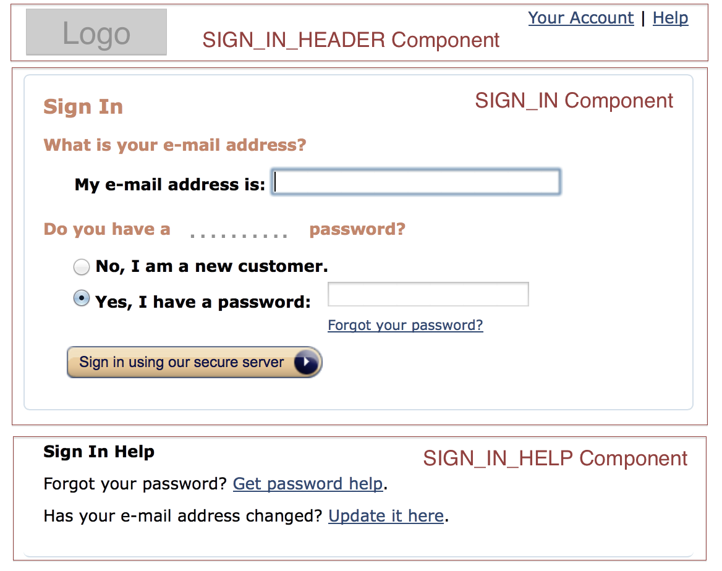
Example 1 Break Page into Components

Slide 4
Name: SIGN_IN Data: email_address customer_relationship_type password Actions: sign_in retrieve_password Configuration (content, images, etc.): sign_in_header email_address_question_label email_address_label password_question_label new_customer_relationship_label password_label retrieve_password_label sign_in_label
Example 1
Component Definition

Slide 5
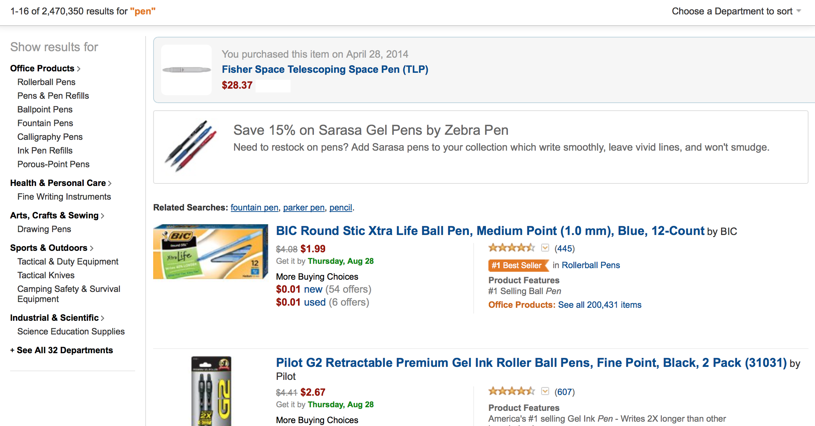
Exercise 1 Product List

Slide 6
Product List Components
SEARCH_RESULTS_HEADER_COMPONENT
PRODUCT_CATEGORY_FILTER_COMPONENT
PURCHASE_HISTORY_COMPONENT
PROMOTIONS_COMPONENT
SEARCH_RESULTS_COMPONENT
PRODUCT_SUMMARY_COMPONENT

Slide 7
Component Definition
PRODUCT_SUMMARY_COMPONENT
Name: PRODUCT_DETAIL_COMPONENT Data: product_name, old_price
new_price, delivery_date
buying_choices_new_price, buying_choices_new_offer_count
buying_choices_used_price, buying_choices_user_offer_count
user_rating, reviews_count, product_tag, product_category, product_features, parent_category_items_count
Actions: view_product_details, view_new_buying_choices, view_used_buying_choices, view_product_reviews, view_products_in_category, view_products_in_parent_category Configuration (content, images, etc.): product_image, product_name_label, old_price_label, new_price_label, delivery_date_label, buying_choices_label, buying_choices_new_price_label,
buying_choice_new_label, buying_choice_new_offer_count_label, buying_choices_used_price_label,
buying_choice_used_label, buying_choice_used_offer_count_label, user_rating_image, user_review_count_label, product_tag_image, product_category_label, product_featrures_label, product_feature_label, product_parent_category_label, product_parent_category_items_count_label

Slide 8
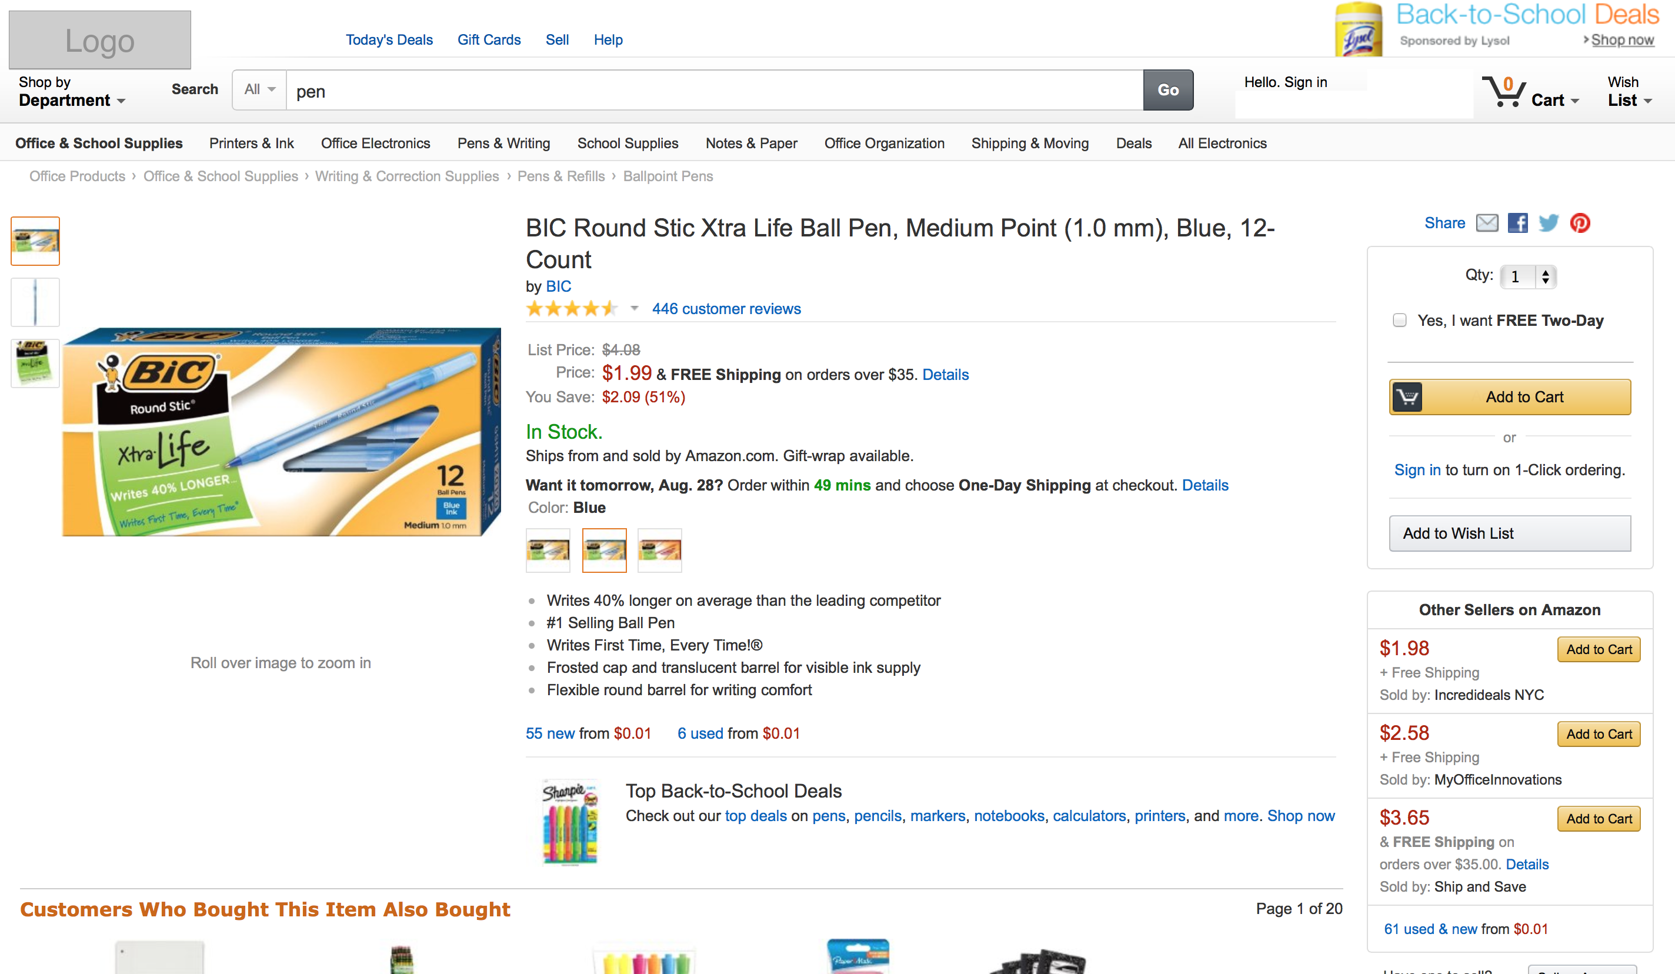
Exercise 1 Product Details

Slide 9
Product Details Component
PRODUCT_SEARCH_HEADER_COMPONENT
PRODUCT_DETAIL_COMPONENT
SHARE_COMPONENT
PURCHASE_OPTIONS_COMPONENT
OTHERE_SELLER_COMPONENT
PRODUCT_MINI_SUMMARY_COMPONENT

Slide 10
Component Definition
Name: PURCHASE_OPTIONS Data: quantity,
is_two_day_shipping_required
Actions: add_to_cart
sign_in_for_one_click_ordering
add_to_wish_list
Configuration (content, images, etc.): quantity_lable
two_day_shipping_label,
cart_image,
add_to_cart_label,
one_click_order_label
add_to_wish_list_label
PURCHASE_OPTIONS_COMPONENT

Slide 11
Exercise 2 API Design for ATM Finder
Instructions
Using the screenshots on slides 8 and 9, please define a RESTful API with clearly defined input and output schema to power a simple ATM search.
This exercise excludes the Advanced Search feature
Anything beyond the search result page is out of scope

Slide 12
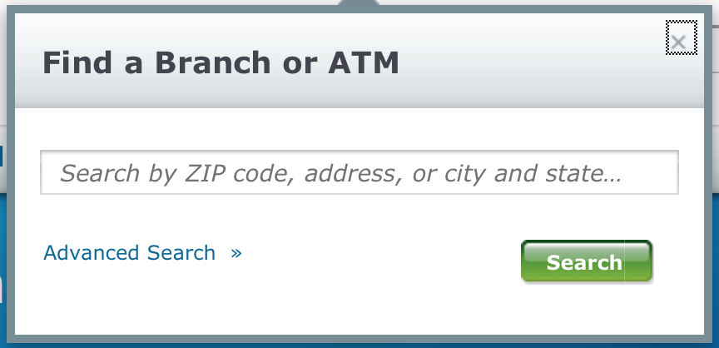
Exercise 2 Simple Search

Slide 13
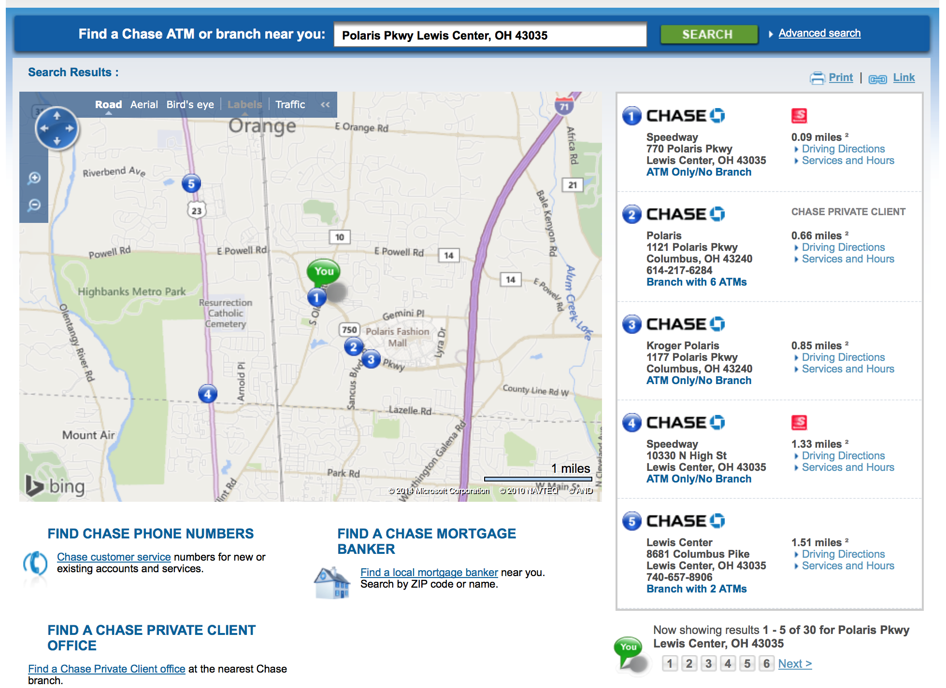
Exercise 2 Search Results

Slide 14
Service Interface Definition

